Slide 1




NEXT GEN EMPLOYABILITY PROGRAM
Creating a future-ready workforce
STUDENT NAME:MEENAKSHI K
REGISTER NO:au820621104042
COLLEGE NAME:ARASU ENGINEERING COLLEGE

Slide 2

CAPSTONE PROJECT SHOWCASE
Project Title
Voting Application using Django Framework-Meenakshi(4042,AEC)
Abstract | Problem Statement | Project Overview | Proposed Solution | Technology Used | Modelling & Results | Conclusion

Slide 3
Abstract
The proposed voting application is a web-based platform that allows users to create and participate in online votes. The application is built using the Django framework, a popular and well-supported Python-based web framework that provides a robust foundation for building scalable and secure web applications . The application is also designed to be flexible and scalable, with a modular architecture that allows for easy customization and extension. This makes it suitable for a wide range of use cases, from small-scale internal votes to large-scale public elections . Overall, the proposed voting application is a secure, user-friendly, and flexible platform for conducting online votes. Its use of the Django framework ensures a robust and scalable foundation, while its focus on security and user experience makes it an ideal choice for a wide range of voting scenarios.

Slide 4
Problem Statement
Online voting has become increasingly popular in recent years, with a growing number of organizations and governments turning to digital platforms to conduct elections and polls. However, online voting also presents a number of challenges, particularly in terms of security and integrity . Overall, the proposed voting application will address the challenges of security and integrity in online voting, while also providing a user-friendly platform for conducting online votes. Its use of the Django framework will ensure a robust and scalable foundation, while its focus on security and user experience will make it an ideal choice for a wide range of voting scenarios.
In addition to its focus on security, the application will also prioritize user experience, with a clean and intuitive interface that makes it easy for users to create and participate in votes. The application will support multiple types of votes, including single-choice and multiple-choice votes, and will allow users to set deadlines and restrictions for each vote.

Slide 5
Project Overview
The project overview for a voting application using the Django framework involves creating a secure and user-friendly online voting system. The application allows users to register, vote, and view real-time results. Here is a steps involved in building the voting application:
Setting up a Django Project: Create a Django project to serve as the foundation for the voting application.
Designing the Database Schema: Define the database structure to store user information, votes, and other relevant data.
Creating User Authentication: Implement user authentication to allow users to register, log in, and participate in voting.
Building the Voting Interface: Develop the interface where users can view options, select their choices, and submit votes.
Implementing Real-time Results: Display the voting results dynamically to provide instant feedback to users.
Developing an Admin Panel: Build an admin panel to manage the voting process, candidates, and user accounts effectively.

Slide 6
Proposed Solution
.
The proposed solution for a voting application using the Django framework is to create a secure and user-friendly online voting platform. The application will allow users to register, vote, and view real-time results . To build the application, the Django framework will be used as the foundation due to its robustness and scalability. The application will have a user-friendly interface, a secure database, real-time results, and an admin panel for efficient management of elections, candidates, and user accounts. In summary, the proposed solution for a voting application using the Django framework is a secure, user-friendly, and flexible platform for conducting online votes. Its use of the Django framework ensures a robust and scalable foundation, while its focus on security and user experience makes it an ideal choice for a wide range of voting scenarios.

Slide 7
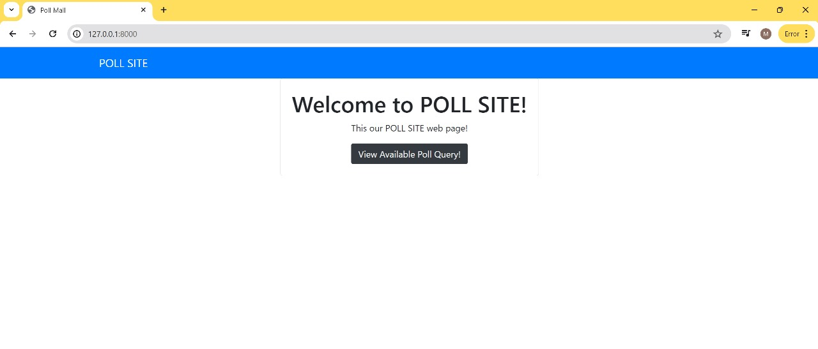
Home Page

Slide 8
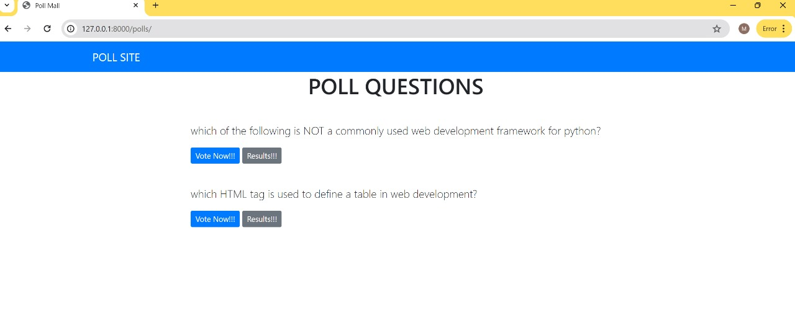
Poll Page

Slide 9
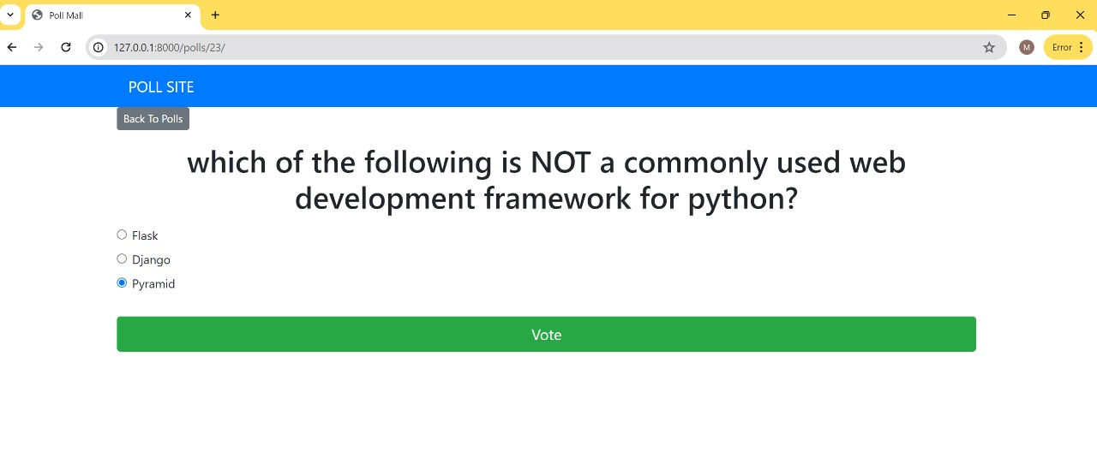
Voting Page

Slide 10
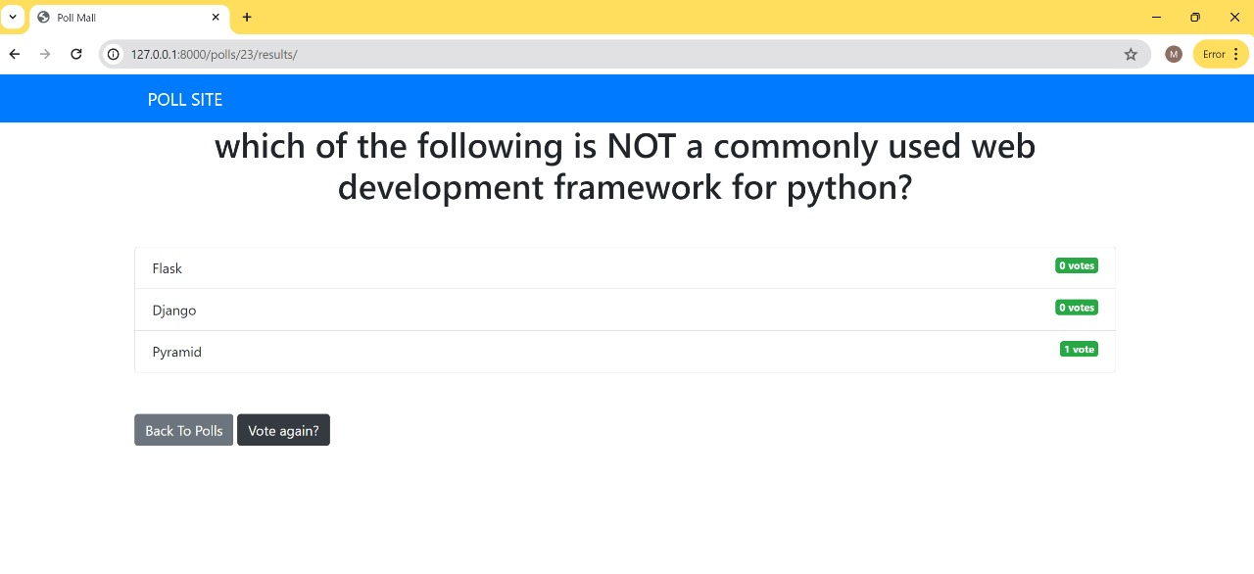
Voting Details Page

Slide 11
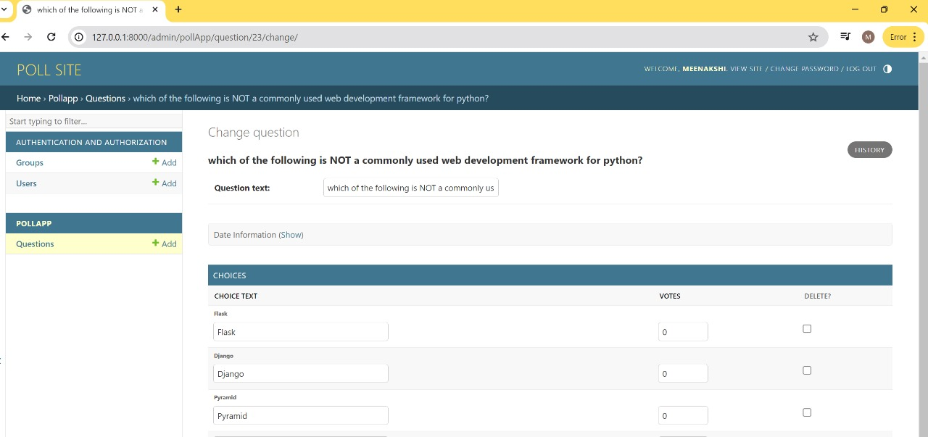
Admin Login Page

Slide 12
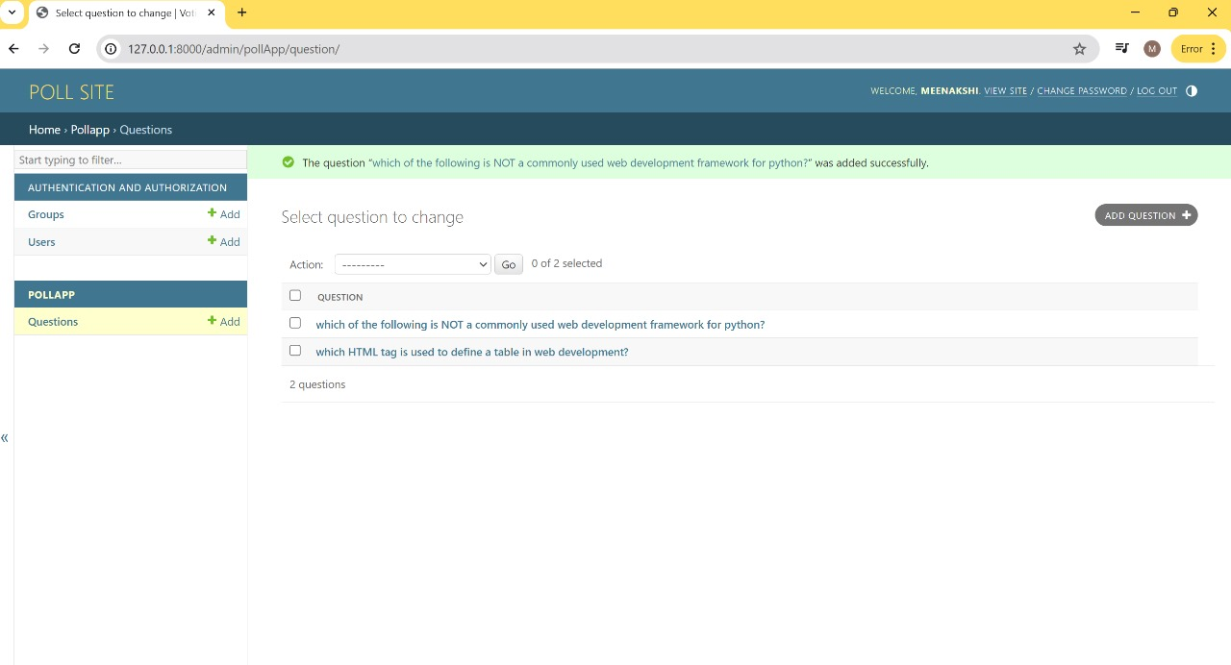
Authentication and Authorization Page

Slide 13


Technology Used
Front-end
Back-end

Slide 14
Future Enhancements:
Future enhancements in a voting application using the Django framework, several key features and improvements can be considered based on the information from the provided sources,
1.Asynchronous Programming: Implementing asynchronous programming can enhance the performance of the application by allowing tasks to run concurrently, improving responsiveness and scalability.
2.Microservices Architecture: Adopting a microservices architecture can make the application more modular, easier to maintain, and scalable by breaking it into smaller, independent services that communicate with each other
3.Serverless Computing: Utilizing serverless computing can optimize resource utilization and reduce costs by enabling automatic scaling and only paying for actual usage, enhancing the application's efficiency and cost-effectiveness.
4.Client-Side Encryption: Enhancing security by implementing client-side encryption can protect sensitive data and ensure the confidentiality of votes, contributing to a more secure e-voting platform.
5.Blockchain Technology: Integrating blockchain technology can provide transparent and verifiable voting processes, ensuring the integrity of elections and promoting trust in the system

Slide 15
Conclusion
To create a voting application using Django, one should have a solid understanding of Python programming, Django framework, HTML, CSS, and Bootstrap. The development process involves creating a new Django project, creating a Django app, defining models, creating views, defining templates, and creating URLs.
The application can be further enhanced with features such as real-time results, a user-friendly interface, and a secure database design. It can also include an admin panel for managing elections, candidates, and user accounts.
Overall, a voting application using the Django framework is a powerful and flexible solution for creating online voting systems that can cater to various use cases and requirements.

Slide 16
Thank You!
Notes:
Thank You !!

